Slide 1

AI-Based Diagnostic Analysis System
For Genetic Disease Detection
An Interpretable Multimodal Deep Learning Framework
by Anubhab Chakraborty

Slide 2
The Problem
Modern medicine generates enormous volumes of fragmented data, with genetic information, medical imaging, and clinical observations existing in separate domains. While each source provides valuable insight independently, genetic diseases often emerge from complex interactions between all three. The current approach treats these sources independently, limiting our understanding of disease mechanisms.

Slide 3

Why Multimodal Integration Matters
Single Data Source Limitations
1
Genomics alone misses phenotypic expression; imaging alone lacks molecular context; clinical data alone lacks mechanistic understanding.
2
Synergistic Insights
Combining all three reveals disease mechanisms that remain hidden in isolation.
3
Real-World Complexity
Genetic diseases manifest through interactions across all three domains.
4
Example
A mutation may correlate with specific imaging patterns only in certain age groups or clinical contexts.
5
Result
More accurate predictions, better clinical relevance, deeper biological understanding.

Slide 4

Project Purpose
Design and implement an AI system that reasons across genomics, imaging, and clinical domains simultaneously
Maintain interpretability and ethical grounding throughout
Function as a decision-support and research tool, not a replacement for clinicians
Surface patterns, associations, and hypotheses that may otherwise remain hidden

Slide 5
Three Data Domains
Genomics
Biomedical Imaging
Clinical Context
High-dimensional sequential data. Millions of base pairs. Long-range dependencies between distant mutations. Transformer-based architectures treat DNA like language.
Structural and functional changes visible in scans. Radiological, histopathology, and other modalities. Vision transformers capture subtle, spatially distributed patterns.
Patient metadata: age, sex, disease history. Modulates how genetic variations express phenotypically. Essential contextual grounding for predictions.

Slide 6
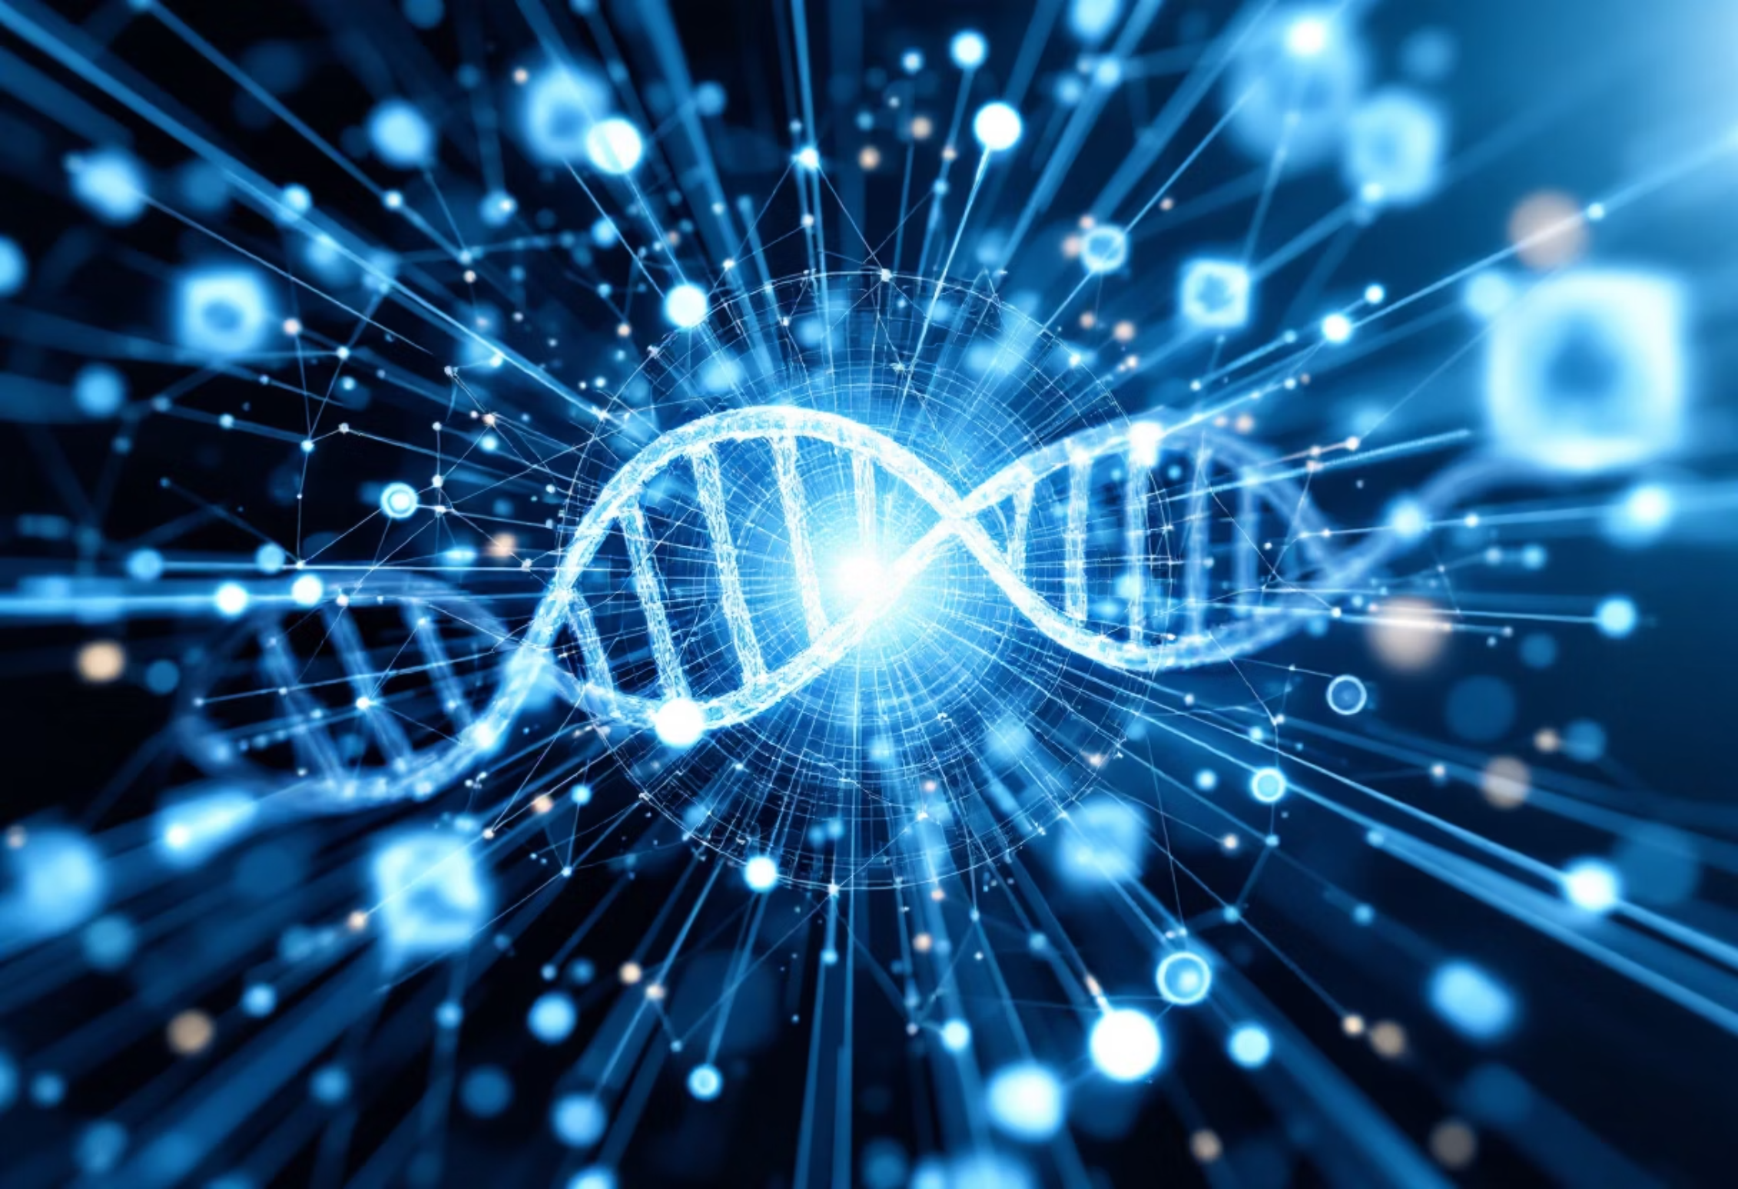
Technical Deep Dive: Transformer Architectures
DNA as Language
Attention Mechanisms
Vision Transformers
Genomic sequences treated analogously to natural language, where subsequences act as meaningful units
Allow models to learn relationships between distant regions of the genome
Unlike CNNs with local receptive fields, learn where to focus attention across entire images
Advantage
Benefit
Capture long-range dependencies and subtle, spatially distributed patterns
More effective at modeling complex biological relationships than traditional approaches

Slide 7
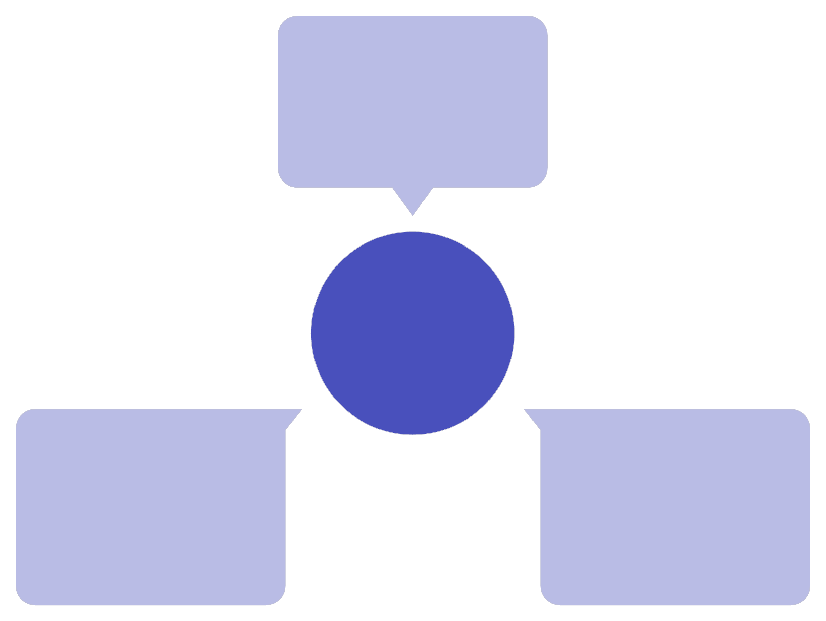
Multimodal Fusion Architecture
Genomic Data
Variants and molecular profiles
Multimodal Fusion Engine
Biomedical Imaging
Clinical Context
Phenotypes and patient history
Radiology and pathology images
Cross-modal attention mechanisms allow genomic, imaging, and clinical representations to influence one another. This enables learning of correlations between genetic variants and imaging patterns under specific clinical conditions. The architecture resembles how human experts synthesize evidence from multiple sources, making it more sophisticated than simple feature concatenation.

Slide 8
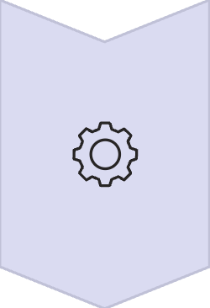


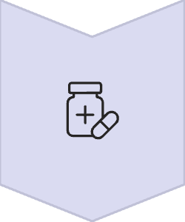

Cross-Modal Attention in Action
How It Works
Genomic representations query imaging features; imaging features attend to clinical metadata; clinical context modulates genomic interpretation.
Example Scenario
System identifies a rare mutation, then searches imaging data for associated patterns, then checks if those patterns appear more frequently in specific age groups.
Emergent Capability
Discovers non-obvious associations that human experts might miss.
Clinical Value
Generates testable hypotheses for further investigation.
Research Impact
Accelerates discovery of disease subtypes and biomarkers.

Slide 9
Dual Learning Strategy
Supervised Learning
Unsupervised Clustering
Reliable labels available (known disease categories, pathogenic variants). Trains on annotated data.
Discovers latent structure within data. Suggests potential phenotype groupings for further investigation. Particularly important where disease boundaries are fuzzy and new subtypes continue to be discovered.

Slide 10
Interpretability & Explainability
Attention Maps: Visualize which regions of images or genomic segments contributed most to predictions
SHAP Values: Provide local and global feature attribution explanations
Integrated Gradients: Show how input features influence model decisions
Principle: Trust is inseparable from transparency in healthcare and genetics
Goal: Help users understand not just individual decisions but overall model behavior

Slide 11
Validation & Performance Metrics
1
Classification Accuracy: Measures correct disease identification across test datasets
2
Sensitivity & Specificity: Ensures both true positive and true negative rates are clinically acceptable
3
Cross-Dataset Generalization: Tests performance across different institutions and populations
4
Attention Map Validation: Confirms that model attention aligns with known disease biomarkers
5
Clinical Expert Review: Domain experts validate that model explanations match biological understanding
6
Benchmark Comparisons: Performance against existing diagnostic methods and single-modality approaches

Slide 12
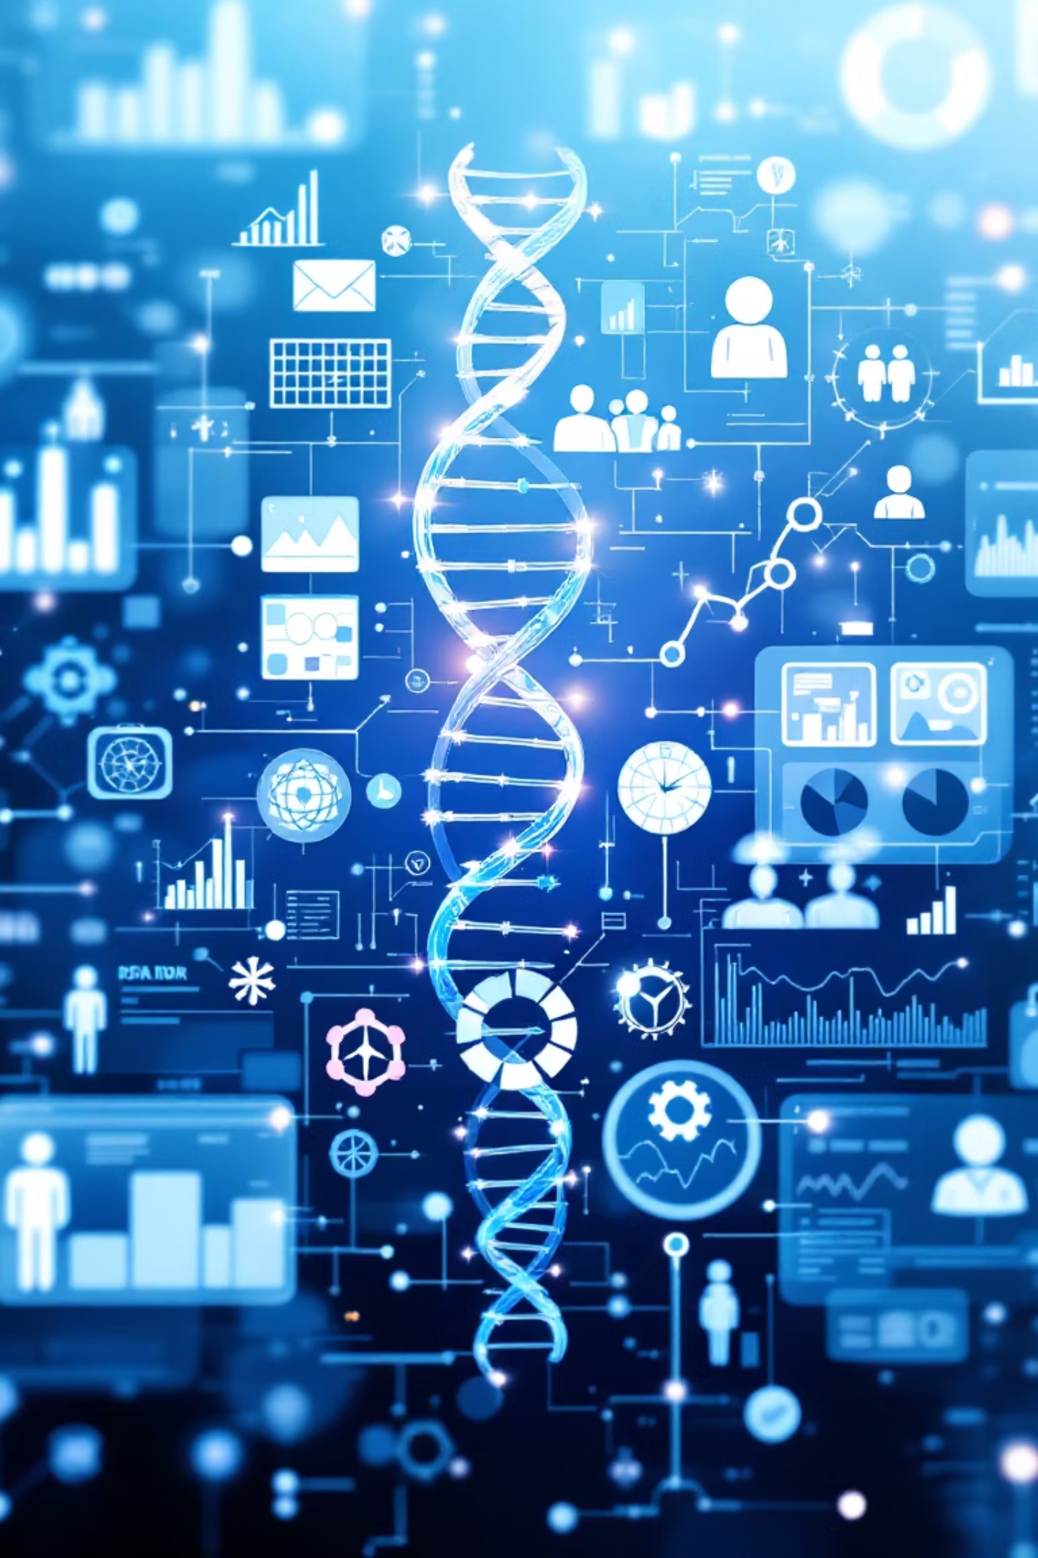
Data Sources & Reproducibility
Genomic Data
Biomedical Imaging
The Cancer Genome Atlas
NIH ChestX-ray14
1000 Genomes Project
Brain Tumor Segmentation challenge datasets
UK Biobank
Variant Interpretation
Design Choice
ClinVar
Multiple datasets reduce dataset-specific bias and test generalization across populations and institutions
Ensembl gene annotations
Emphasis
Publicly available datasets ensure reproducibility and scientific credibility

Slide 13
Ethical Considerations
Genetic data is among the most sensitive forms of personal information.
Misuse can have serious consequences.
Privacy & Data Governance
Regulatory Alignment
Anonymization, controlled access, human-in-the-loop decision-making
GDPR and HIPAA principles
System Framing
Role
Assistive tool, not autonomous diagnostic authority
Domain experts remain central to interpretation and decision-making

Slide 14

Addressing Bias & Fairness
Population Diversity
Bias Detection
Training data includes diverse ethnic backgrounds, geographic regions, and socioeconomic contexts
Systematic evaluation of model performance across demographic groups
Fairness Constraints
Transparency in Limitations
Ensures predictions don't systematically disadvantage any population
Clear documentation of where model performance varies by population
Continuous Monitoring
Stakeholder Engagement
Ongoing assessment as system is deployed in real-world settings
Collaboration with patient advocacy groups and diverse clinical teams

Slide 15

System Architecture & Engineering
Modular Design
Components
Each component clearly separated and documented
Preprocessing pipelines
Model architectures
Training scripts
Evaluation modules
Reproducibility
Extensibility
Suitable as academic exercise and foundation for future research
Designed for industry deployment and ongoing development
Suitable for
Research, clinical applications, and continuous improvement

Slide 16
Future Extensions & Applications
Graph Neural Networks: Model gene-gene interactions
Additional Omics Data: Transcriptomics, epigenomics integration
Bayesian Uncertainty: Quantify prediction confidence
Drug Target Discovery: Identify therapeutic targets
Clinical Trial Stratification: Patient population segmentation
Continuous Evolution: System designed to grow and adapt

Slide 17
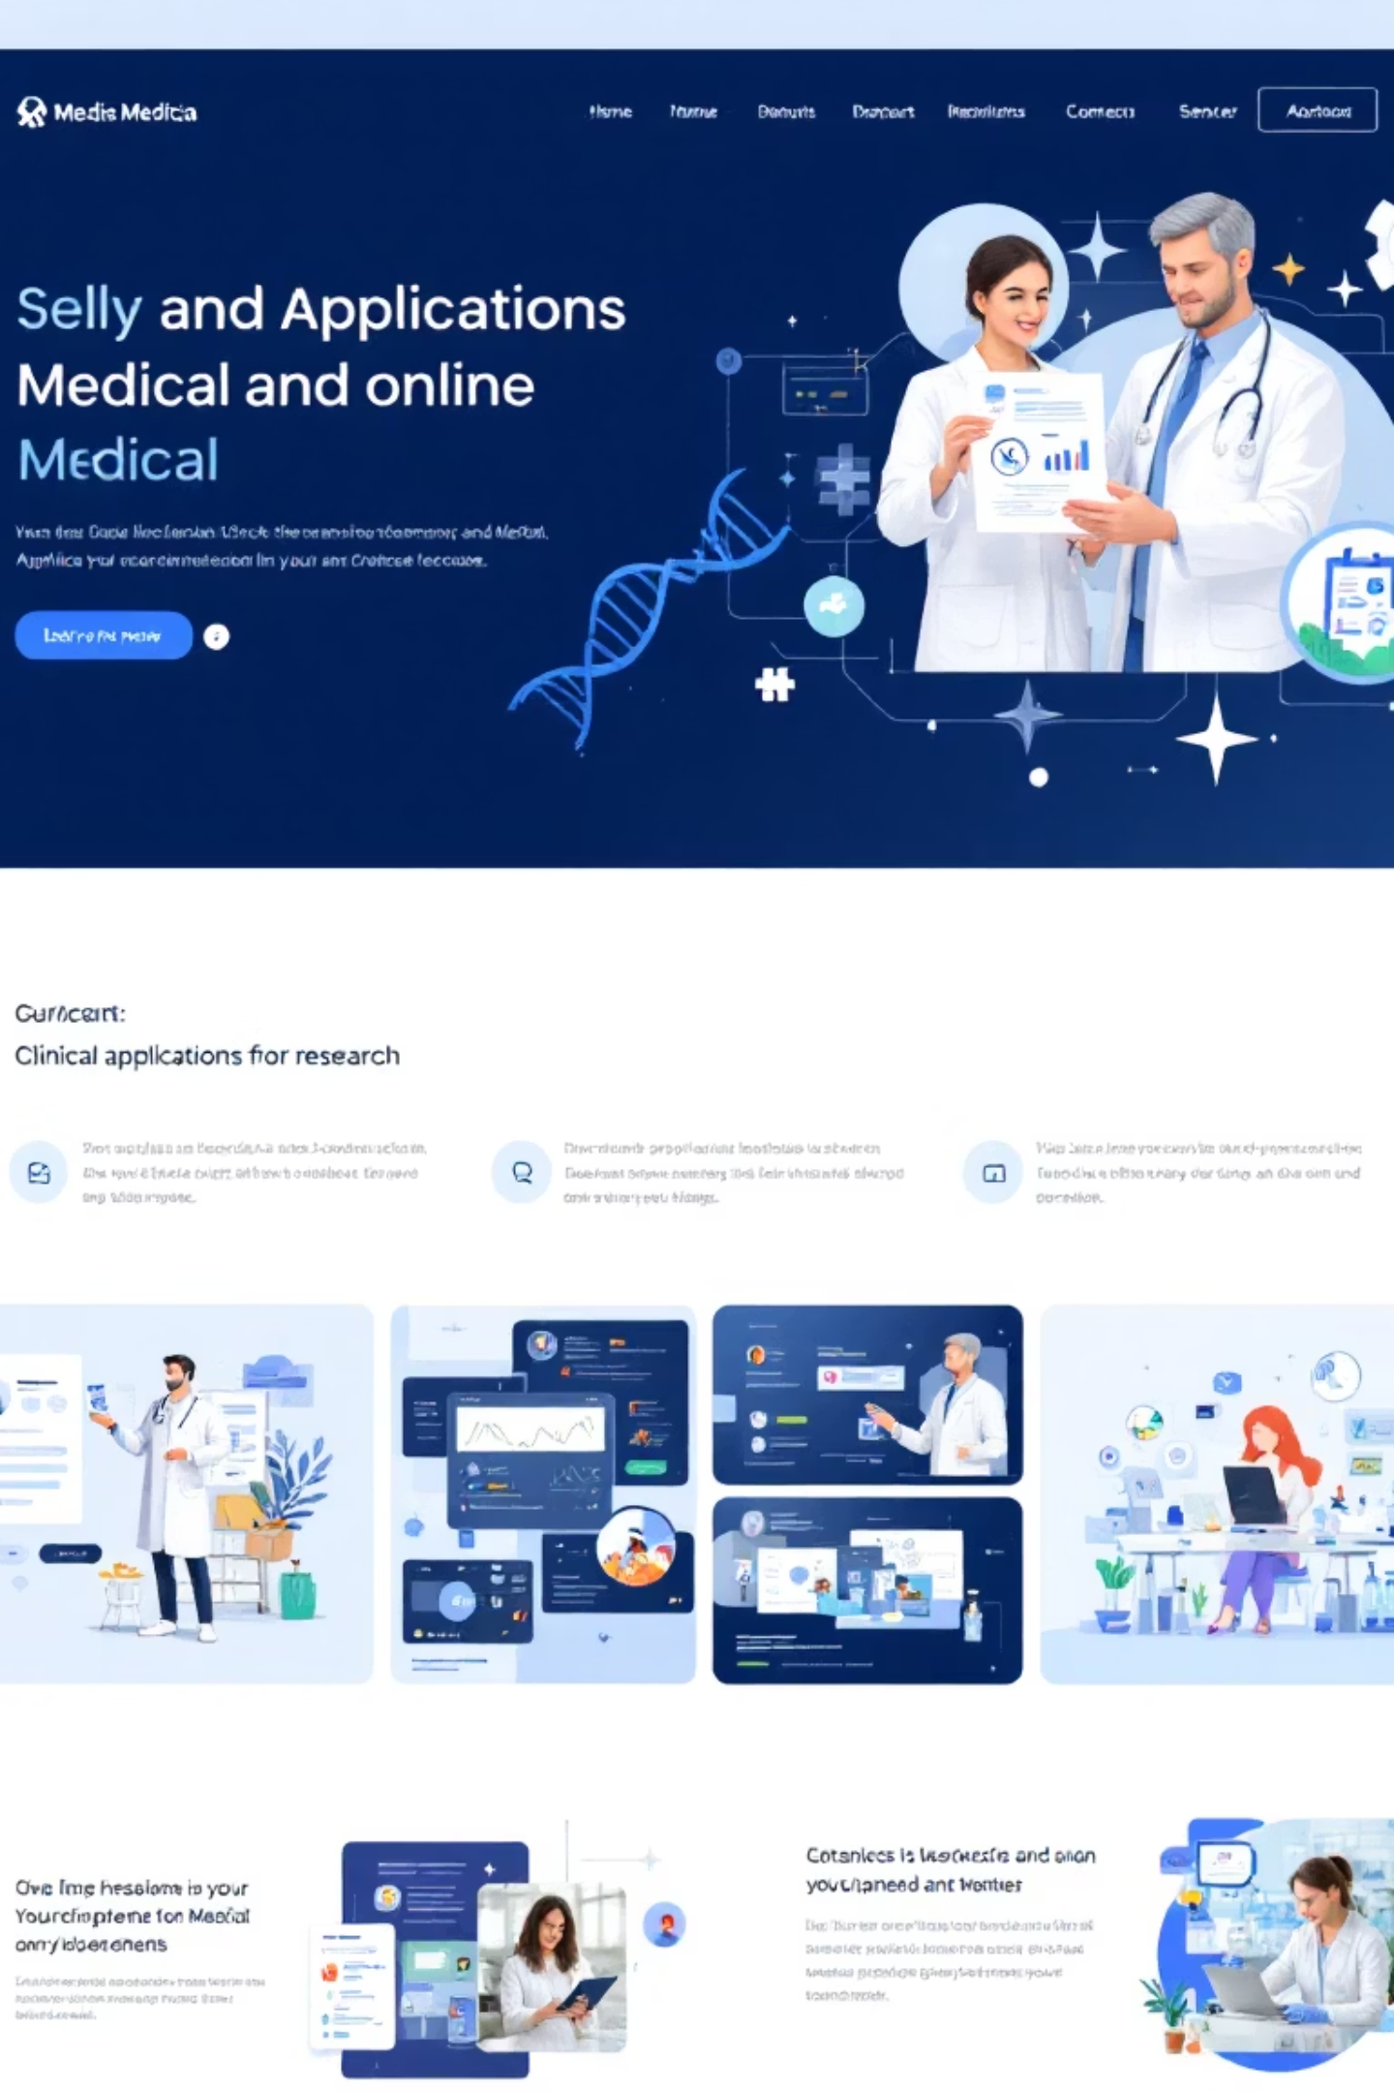
Real-World Clinical Applications
Rare Disease Diagnosis
Accelerate identification of rare genetic conditions where expertise is scarce
Precision Medicine
Tailor treatment recommendations based on individual genetic and imaging profiles
Risk Stratification
Identify high-risk patients who need intensive monitoring or early intervention
Treatment Selection
Guide choice of therapies based on predicted response patterns
Research Acceleration
Enable discovery of new disease mechanisms and biomarkers
Patient Outcomes
Improve diagnostic accuracy and reduce time-to-diagnosis

Slide 18
Key Takeaways
Bridges computational science and biomedical understanding
Technically rigorous, ethically responsible, and practically relevant
Requires not just more data or larger models, but better integration
Demands clearer explanations and transparency
Reflects deep respect for complexity of biological systems and human health
Positions AI as a collaborative partner with domain experts, not a replacement

Slide 19
Implementation Roadmap
Phase 1 (Foundation): Build core architecture, integrate datasets, establish baseline performance
Phase 2 (Validation): Clinical validation studies, expert review, bias assessment
Phase 3 (Deployment): Pilot deployment in clinical settings, real-world performance monitoring
Phase 4 (Scaling): Expand to additional disease domains, integrate new data types
Phase 5 (Integration): Full clinical workflow integration, regulatory compliance
Timeline: Multi-year development with continuous feedback loops and iterative improvements

